Slide 1
Garden Assistant App
Low Fidelity Prototype

Slide 2
Login Screen:
Garden Assistance
If the user inputs a matching username and password, they’ll be given access to their account.
Username…
Password…
If that user is new (they don’t have an account), by clicking on this they can create one.
Forgotten username?
Forgotten password?
New user?
If the user already has an account but has forgotten either their username or password, they can click this, to create a new one.

Slide 3





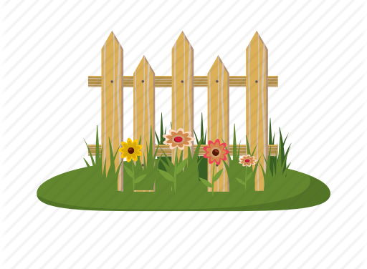
Garden Assistance
Home Screen:
This icon represents the account that the user is on. This account is unique to the user, with all their data saved onto it (e.g. all their drawings/calendar alerts/etc.)
DRAW
DATABASE
Scroll down
CALENDAR
Garden Assistance
CALENDAR
Each of these are buttons that direct the user to different tabs that they choose to click depending on what they want to do.
For example, if they want to draw a new design for a garden they will probably use the draw tab, or if they want to look up information regarding a certain plant, they’ll probably use the database tab.
FORUM
MyGarden

Slide 4




These icons represent the save button and the delete button.
If the user has made changes to their previously saved drawing, then tapping this button will simply save the new changes. However, if the drawing has never been saved before (e.g. it’s new), then a prompt will appear, requesting the user to name the new drawing.
Clicking on the delete button opens a prompt asking the user if they really want to delete the drawing they’re on. If ‘no’ is selected, then the user is simply sent back to the drawing. However, if ‘yes’ is selected, then the drawing is permanently deleted.
Drawing Tab Screen:
These icons represent two different modes.
The pencil icon represents ‘drawing mode’ where you can use the plants/shapes on the left-side to draw the garden.
The eraser icon represents ‘deletion mode’ where the user can delete parts of the garden that they may not like after consideration.
*Different plants and shapes would be placed here.*
Variety of different plants in different forms (square blocks, circles, etc.) will be placed on the side so users can click on which one they want to incorporate into the design of their garden.
These icons represent ‘Undo’ and ‘Redo’.
By tapping on the undo button, it allows the user to undo their last input (whether it was drawing or deletion).
By tapping the redo button, it allows the user to ‘undo their undo’ (if they use undo but choose that they liked it better before they did it, they can go back to how it was before undo was used).
This box is the area where the users will be able to draw out what the garden will look like.
These are buttons that users can tap that will quickly navigate them to the features on the app, reducing the time needed (they won’t have to navigate constantly back and forth between the home page and where they want to go).

Slide 5
Search bar where users can type in the name of whatever plant they want to know about.
Users could either type in the plant’s common name (e.g. sunflower) or it’s scientific name (e.g. helianthus annuus) to get the same result.
Database Tab Screen:
The general information section gives the user basic information about the plant, such as:
It’s scientific name/family/kingdom/etc.
Where it grows.
Trivia about the plant e.g. how high it grows, what it’s used for (medicinal properties?).
Search
*Example plant title*
General information:
………………………….
………………………….
……………………….....
Plant requirements:
…………………………
…………………………
After searching for and clicking on the intended plant, a stock image of the search is generated and shown to the user.
*Image of plant goes here*
The plant requirements section goes into very specific detail regarding what the user needs in order to successfully grow that specific plant.
It may tell the user:
What seeds are needed.
What type of soil (firm or soft, etc.)
What type of weather is preferable/needed.
Where is it grow most efficiently (which country).

Slide 6
The arrow keys allow them to traverse forwards and backwards in time, so they can plan out what they want to do in advance to set early reminders or see what reminders have already been set, or to go back and see what reminders were set in the past.
The search bar allows users to type in specific words that relate to reminders that they or the app has set, so that they can look at only those reminders.
For example, typing in ‘sunflower’ would only bring up the reminders that relate to sunflowers (e.g. replant sunflower seeds on 16th Nov 2019).
Calendar Tab Screen:
The ‘+’ symbol gives users the ability to set their own reminders, for things that the app may not set reminders for.
When using this, it gives them the ability to name the reminder, choose when to receive the alert (e.g. one day early), etc.
Nov 2019
Search
M T W T F S S
28 29 30 31 1 2 3
4 5 6 7 8 9 10
11 12 13 14 15 16 17
18 19 20 21 22 23 24
25 26 27 28 29 30 1
This dot signifies that the date (above the dot) has a set reminder.

Slide 7
Forum Tab Screen:
The ‘+’ symbol gives users the ability to make their own posts on the forum, under the username of the account they’re using.
Search
*Forum post title 1* by *Username of author*
*Opening sentence of the post content here.*
*Forum post title 2* by *Username of author*
*Opening sentence of the post content here.*
*Forum post title 3* by *Username of author*
*Opening sentence of the post content here.*
The search bar gives user the ability to search for specific posts by inputting particular words.
For example, by inputting ‘seeds’, they may see posts regarding seeds (e.g. how many seeds should be planted, where to buy seeds, etc.).

Slide 8
The search bar gives the user the ability to input certain words that may match what they named the title of one of their garden drawings to find those drawings specifically rather than sorting through them manually.
MyGarden Tab Screen:
The ‘+’ symbol gives users the ability to create new garden designs.
Search
These images will be screenshots from the drawing section of the app, so that users can see which garden is which, in case they forgot what they named the garden they want to open.
*Image of garden drawing*
*Title of Garden*
Users can choose what to call their garden, which is what’ll appear here, so they can find the one they’re looking for.
*Image of garden drawing*
*Title of Garden 2*

